Slide 1

Happiness of the World over Time
Jordan Dubeck, Jane Harvey, Justice Milhoan, Grace Placko & Madison Zursin
Notes:
hello (say names)
Our project we focused on looking at happiness of the world of time

Slide 2

Our data: World Happiness Report (via kaggle)
The World Happiness Report calculates the relative happiness of countries
Economy
Health
Trust in government.
Happiness is based on a scale from 0 to 10. The happiness of a country is based on its individuals.
Notes:
The World Happiness Report, using data from the Gallup World Poll, calculates the relative happiness of countries based on various factors, like the economy, health, and trust in government to name a few.
People rate their happiness on a scale from 0 to 10, with 0 least happy and 10 most happy. This is then compiled to describe the happiness of a country based on its individuals' opinions.
This project displays data about the happiest countries in the world, and the factors which contribute to this happiness.

Slide 3

Questions We Want to Explore
What are the happiest countries?
How strongly do the factors given correlate with a country's happiness?
Have a country’s happiness score changed over time?
Notes:
Looking at the data given some of the questions we wanted to explore was what countries are the happiest out of all the years given?
How strongly are the factors that the dataset has correlate to the country's happiness? Which factors might have led to people saying they are happy?
Have the countries scores changed over time? And how so? Are there consistencies in who is at the top or is there a lot of fluctuation?

Slide 4

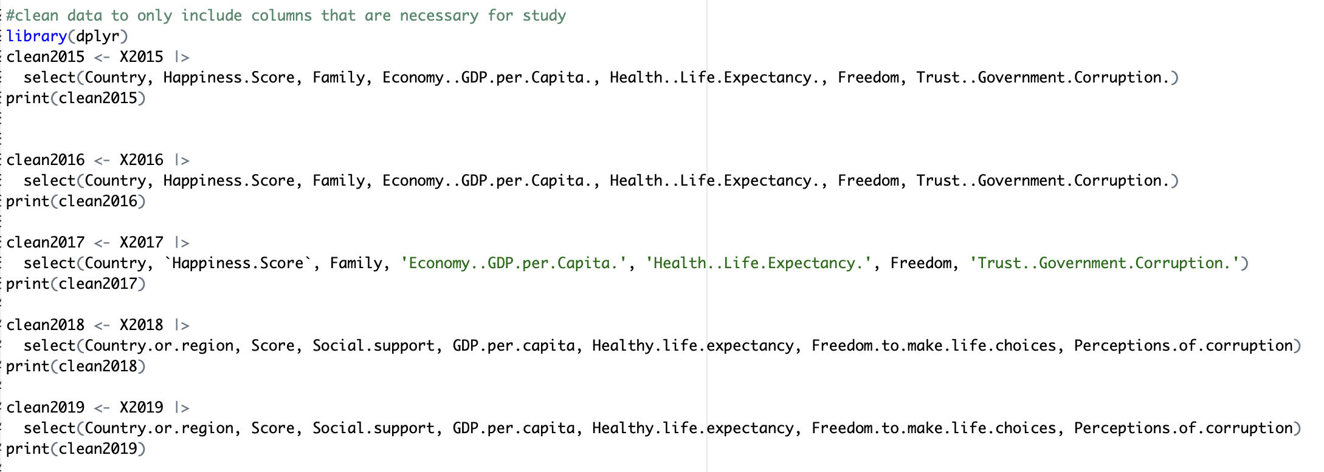
Cleaning the Data &
Defining Variables
Happiness score (0-10)
& Country
Important social
"factors”
Time
Notes:
We chose variables that corresponded with the questions we wanted to answer
happiness score to get the overall evaluation and to answer our question of which one is the happiest.
The social factors that were given to see which ones had a bigger impact, and they are factors that can be changed and influenced by the government to help their country improve their happiness score
And time to answer our questions of how variable is the top happiest countries
Data that did not help to answer these questions was removed from our file in favor of our main variables.
We wanted to show exactly the variables that we extracted from the data set, and we maintained them in their individual years

Slide 5
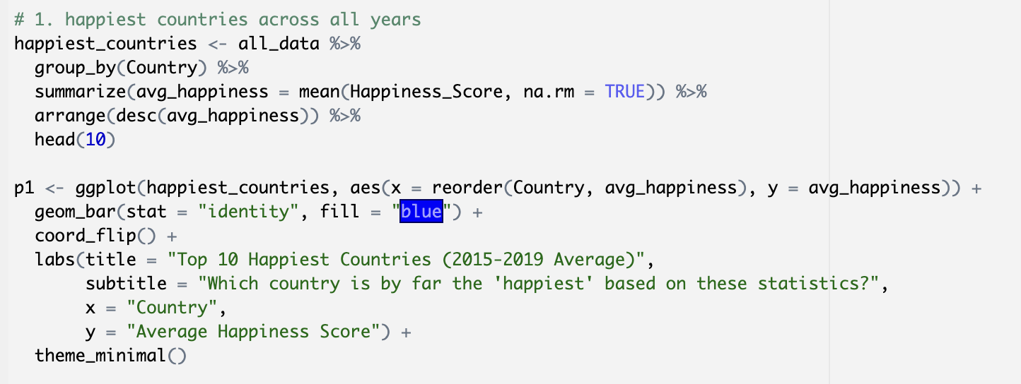
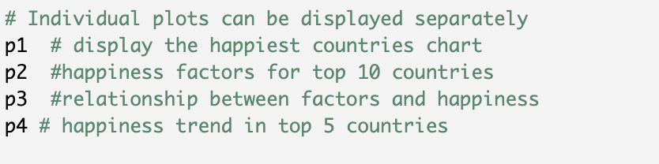
Our code (Happiest Countries)
Notes:
Just a brief look into some of our code to show how we got the top 10 happiest countries

Slide 6

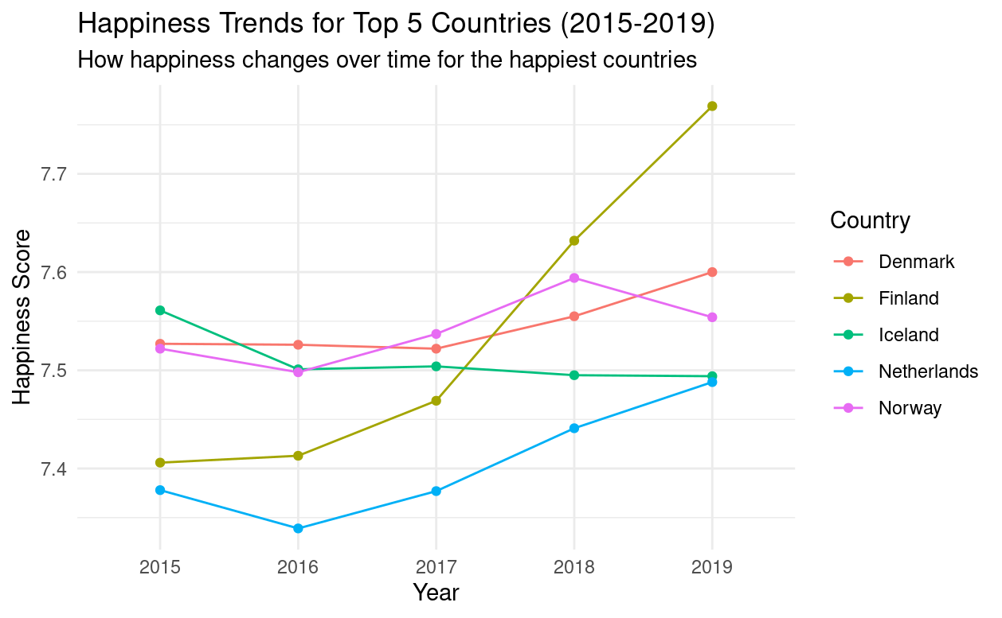
Notes:
Here we have a line graph where our x axis is showing years, y axis is showing level of happiness score and the plots are connected to each countries score over the years to show us their trends of their rankings
Denmark, Norway, Finland, Switzerland, and Iceland are the top 5 happiest countries
We took the average of every countries happiness scores to find the top 5 and then plotted them on a graph showing the evolution of their scores
We notice that there have been some consistencies with Denmark, Norway, and Iceland as their score has stayed pretty stable over the years. There hasn’t been any dramatic drops in happiness so the factors that influence hapiness must be something that once in place can be stable, like possibly freedom, health, family, government trust?
Finland is the country whose happiness has improved most over time, and has the greatest changes in happiness over time which we could make the assumption that happiness can be something that could be easier to improve than worsen.

Slide 7
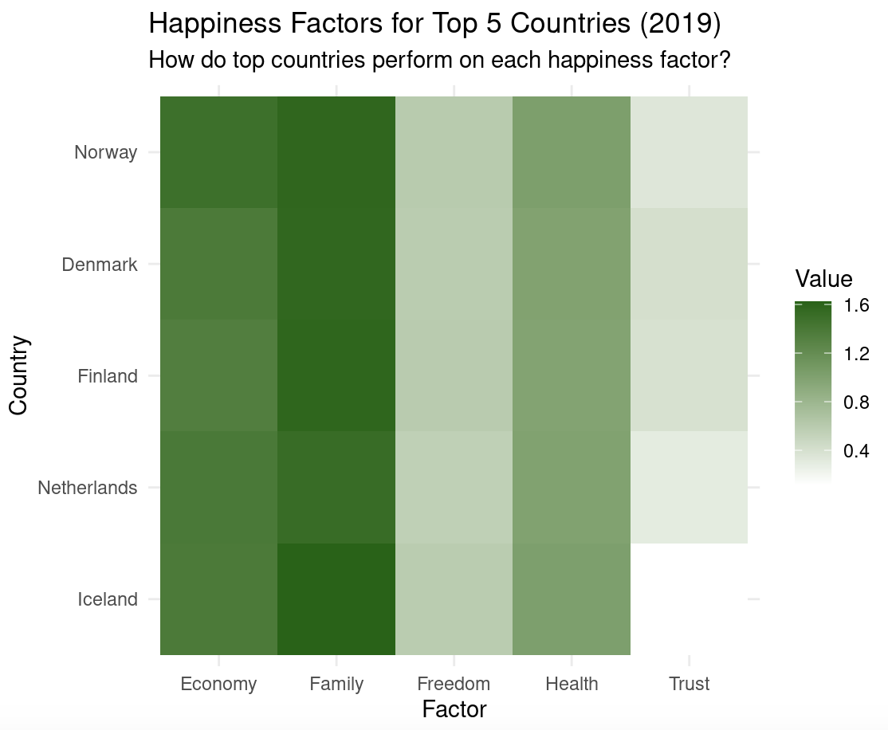
Notes:
Here we have graph where on the x axis we have factors, and then on the y axis we have the top 5 countries. The darker the green the higher value a factor had on the country’s happiness score
The top 5 countries consistently have family and economy as the top factors to contribute to happiness, meaning we can assume that these factors have more of an impact of happiness than the others. Health is a bit darker showing that this is a common factor that might have been for a person to happy.
Freedom and Trust apparently did not have an impact on people’s happiness, so it could mean that people dont consider these factors to their happiness, it might be because these are things that individuals might not look at, and they are more so factors relating to a population.

Slide 8
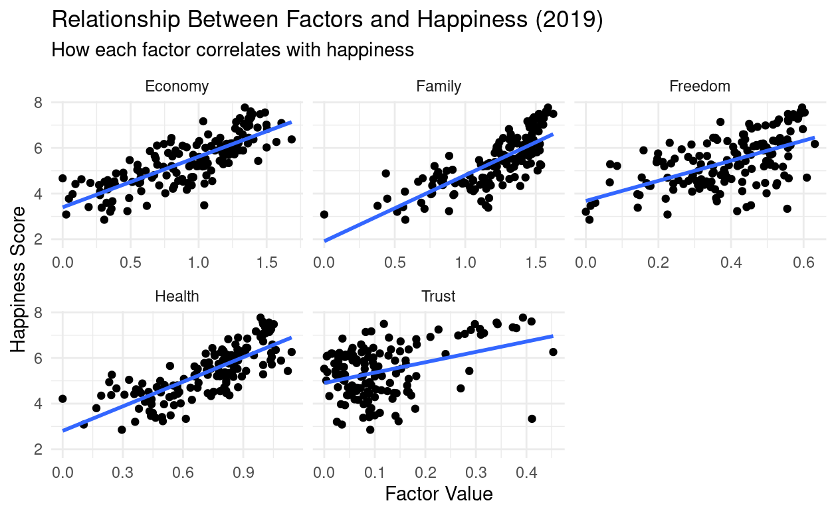
Notes:
To continue our investigation on the impact of factors on scores we wanted to look at if the score of a certain factor was higher, how that influenced the overall happiness score.
The 5 graphs are for each factor, the total data was used in 2019, x axis has the value of the factor, and the y axis has the value of the happiness score. Then we plotted an average trend line to get a look at relationship between the values.
We can see that economy, family, and health have the steepest lines. Meaning that the higher their values are the more likely that that overall happiness score will be higher, so to improve your happiness score these would be the factors you would want to target. Freedom and trust don’t have that steep of a slope meaning their increase in values doesn’t improve the happiness score that much. Also noting their y intercepts you can see that they have a less initial impact on the happines factor compared to family for example.
Trust doesn’t have as much of an impact on happiness, while economy, health, and family have a much more consistent contribution to happiness

Slide 9
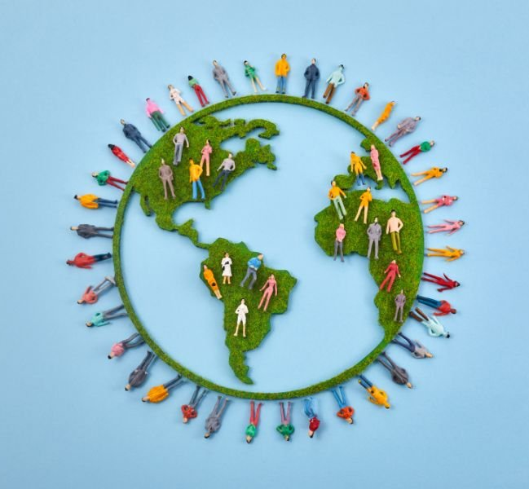
Conclusions & interpretation of data
Denmark, Norway, Finland, Switzerland, and Iceland are the top 5 happiest countries
Finland is the country whose happiness has improved most over time
The top 10 countries consistently rank family and economy as their top happiness factors
Trust doesn’t have as much of an impact on happiness, while economy, health, and family have a much more consistent contribution to happiness
Notes:
To wrap it up for our main conclusions were…

Slide 10

Q&A

Slide 11
